Slide 1



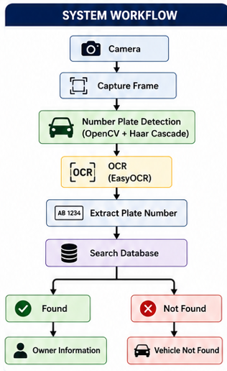
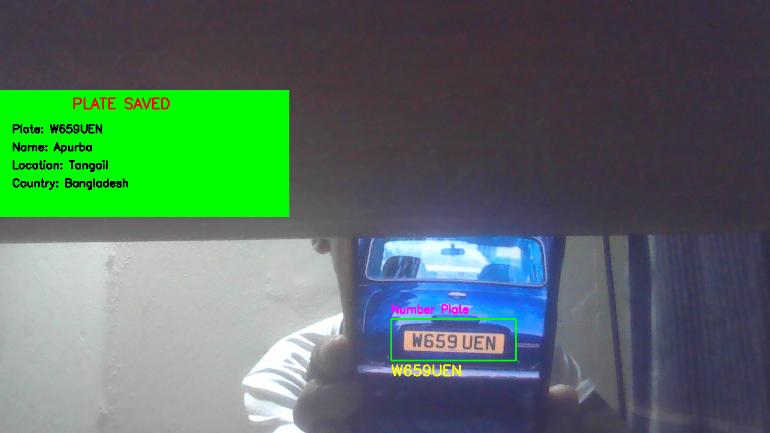
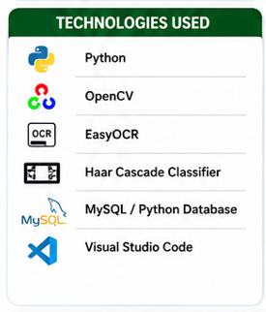
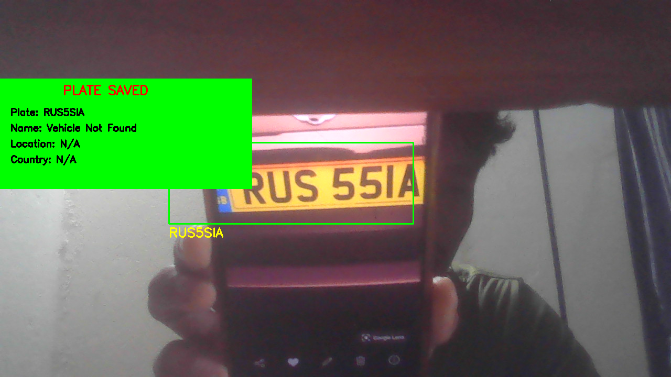

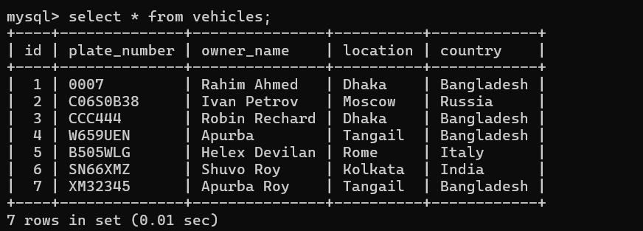


PROJECT OBJECTIVE
SYSTEM OUTPUT
The objective of this project is to develop a real-time Automatic Number Plate Recognition (ANPR) system that detects vehicle number plates using a webcam, extracts the plate number using OCR, and retrieves vehicle information from a database.
1. Vehicle Found:
Plate: W659UEN Name: Apurba Location: Tangail Country: Bangladesh
2. Vehicle Not Found:
Plate: RUS55IA Status: Vehicle Not Found
Location: N/A Country: N/A
ADVANTAGES
• Fast vehicle identification • Low-cost implementation • Real-time processing • Easy to maintain • Useful for parking & toll plaza checkpoints
DATABASE STRUCTURE
FEATURES
• Real-time webcam detection • Number plate recognition • OCR text extraction • Vehicle information lookup • Save detected plate image • Display owner details (Name, Location, Country)
FUTURE WORK
• MySQL Cloud Database Integration • Multiple Camera Support • Face Recognition Integration • Automatic Fine Generation • Stolen Vehicle Detection • Web Dashboard & Mobile App Integration
CONCLUSION
ALGORITHMS USED
SAMPLE SAVED IMAGE
Haar Cascade Classifier: Detects the number plate from the camera image. EasyOCR: Extracts characters from the detected plate image. Database Matching: Compares detected number with stored records.
The developed Automatic Number Plate
Recognition system successfully detects
vehicle number plates, recognizes the
plate number using OCR and retrieves
vehicle information from a MySQL database.
The system can be used for parking,
security, toll collection and smart city
applications.
PRESENTED BY
Apurba Chandra Roy
IT-23031
Department of ICT
Mawlana Bhashani Science and Technology University
SUPERVISOR
Dr. Ziaur Rahman
Associate Professor
Department of ICT
Mawlana Bhashani Science and Technology University

